Slide 1
California High-Speed Train Construction Package 2-3 Business Opportunities Briefing
July 7, 2014 Hanford, California

Slide 2
Purpose
Introduce Tutor Perini/Zachry/Parsons, a Joint Venture (TPZP) to Hanford and the Central Valley Community
Identify Local Firms to Support TPZP:
Small Businesses (SB)
Disadvantage Businesses Enterprises (DBE)
Disabled Veteran Businesses Enterprises (DVBE)

Slide 3
Agenda
Introductions
TPZP Community and SB/DBE/DVBE/MB Commitment
California High-Speed Rail Construction Package 2-3 (CP 2-3) Overview
Subcontracting Opportunities
Subcontractor Registration Process
Q&A

Slide 4
TPZP Overview
Headquartered in California with over 10,000 employees worldwide
#13 on Engineering News-Record’s (ENR) Top Contractors list (2014)
More than 100 years of successfully building heavy civil infrastructure projects
Legacy of heavy construction dating back to 1924
Owned and operated three railroad lines, including the Pecos Valley Southern Railroad
Has completed several Leadership I Energy and Environmental Design (LEED)-certified projects, including the first LEED Gold-certified building in San Antonio, at its corporate headquarters.
Headquarters in California with 15,000 people worldwide
More than 70-year history of delivering rail and infrastructure projects in California and across the globe
Experience with passenger trains and freight railroads
TPZP AWARDED CP 1 – MADERA TO FRESNO

Slide 5
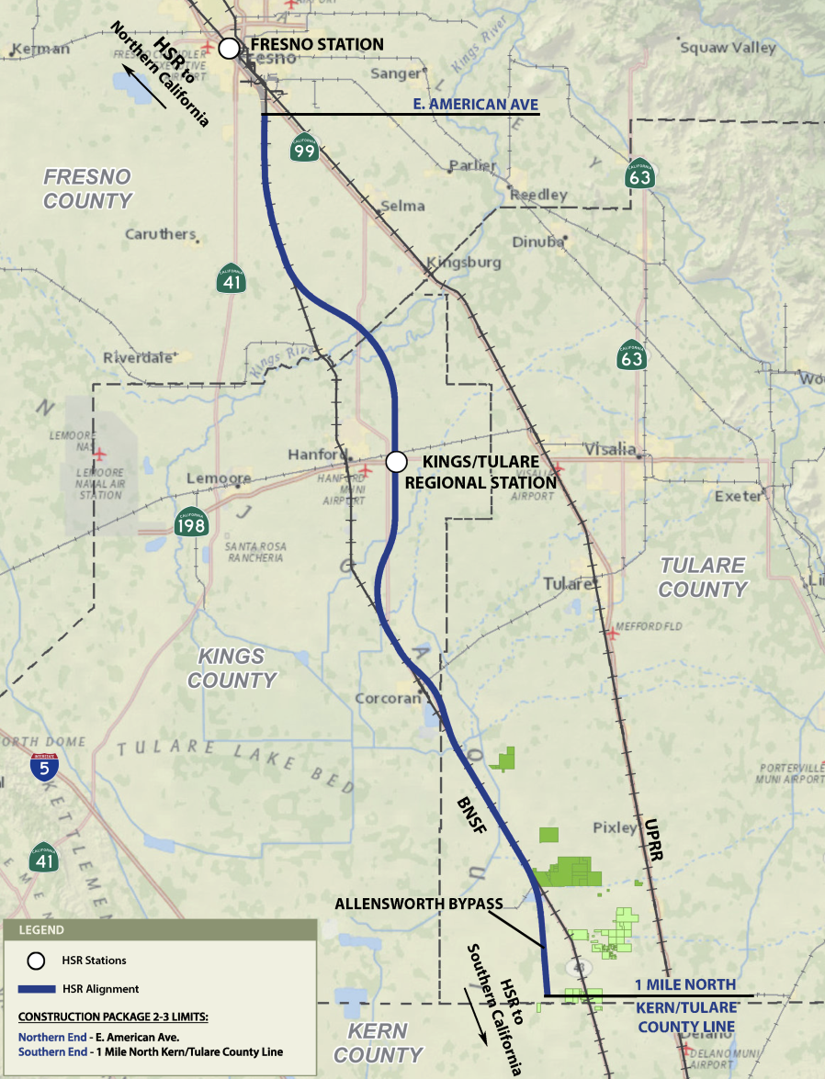
CP 2-3 Project Overview

Slide 6
CP 2-3 Project Overview
DATE | SCHEDULE
October 10, 2013 | Issue Request for Qualifications (RFQ) for Design-Builders (Completed)
February 19, 2014 | Shortlist Proposers Approved (Completed)
April 3, 2014 | Issue Request for Proposals (RFP) for Design‐Builders (Completed)
July 7, 2014 | TPZP Hanford Community Outreach Event (In Progress)
October 3, 2014 | Bidders Submit Response to RFP to Authority
November 2014 | Authority Approves the Award of Design-Build Contract
First Quarter 2015 | Notice to Proceed (NTP)
Early 2018 | Project Completion

Slide 7
CP 2-3 Project Overview
Project extends from E. American Ave in the southern part of the City of Fresno to approximately one mile north of the Tulare-Kern County line
Approximately 65 miles long
Design and Construction will include 36 grade separations in the counties of Fresno, Kings, and Tulare, including viaducts, underpasses and overpasses, utility relocation, road relocations, realignment of existing RR tracks
Estimated at $1.5 to $2 billion award amount
Authority’s SB goal is 30% (including 10% DBE and 3% DVBE)
NTP in First Quarter 2015 and built in 35 months

Slide 8
TPZP Commitment to the Community
TPZP has a long-standing commitment to small businesses and the communities in which we work
We will establish relationships with our subcontractors that build capabilities and capacity for local firms and SB/DBE/DVBE/MB
Each JV partner has a demonstrated track record of projects where we went above and beyond the established goals…resulting in recognition and awards
Mentor-Protégé involvement includes the Caltrans Calmentor and TxDOT Prime Contractor Program

Slide 9
TPZP SB Program Goals/Objectives
Achieve and exceed the 30% SB goal (with 10% DBE / 3% DVBE goal)
Create a level playing field on which SB firms can complete fairly for subcontracts
Remove SB participation barriers in the bidding, award and administration of subcontracts
Encourage non-SB subcontractors to subcontract to SB firms for lower-tier subcontracts.
Ensure SB firms meeting the eligibility requirements are allowed to participate.
Identify business enterprises that are qualified as SB firms and are qualified to provide the required contracting, materials, services, and supplies.

Slide 10
TPZP Five-Phases SB Program
MONITOR/TRACKING/REPORTING
Contract Analysis and Opportunity Detection
Information Acquisition and Database Management
Contract Packaging and Outreach
Engage Subconsultants Subcontractors Vendors, and Suppliers
Technical Assistance and Mentoring During Subcontract Execution
1
2
3
4
5

Slide 11
TPZP Small Business Plan Efforts
To ensure that SB/DVBE/DBE/MB firms have an equitable opportunity to compete for subcontracts on the project, we will:
Utilize our existing database, which will be routinely updated and expanded
Maintain contact with associations, chambers, industry organizations, etc.
Host and attend workshops, seminars, and networking events.
Utilize Small Business source lists, guides and other data identifying SB/DVBE/DBE/MB firms.
Provide assistance to obtain certification, bonding, lines of credit, and /or insurance
TPZP’s efforts to identify and award contracts to SB/DVBE/ DBE/MB will include:
Identification of SB/DVBE/DBE/MB firms that can contribute to the project team
Facilitate Information Session(s) - provide opportunities for networking
Focus our General Conditions subcontract awards towards SB/DVBE firms
Organize ‘bid packages’ or Scope of Work in a manner that is inviting to SB/DVBE/DBE/MB firms
Provide equal opportunity

Slide 12
High-Speed Train CP 2-3 Design-Build Subcontracting Opportunities
This is a very large civil project and will require a lot of different disciplines:
General engineering and design
Professional services
Construction and construction related services
Administrative support services
Other support services

Slide 13
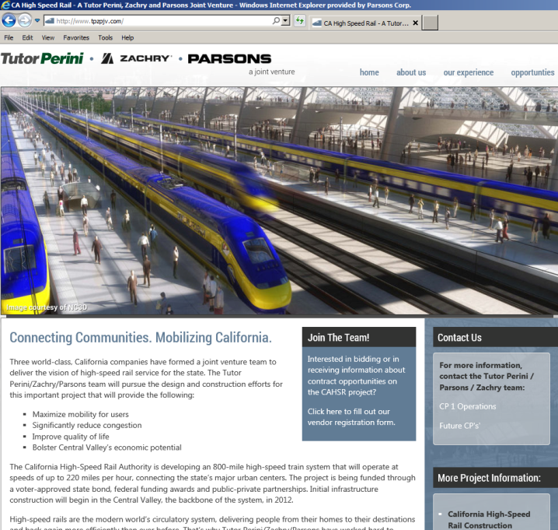
Registration & Procurement Process
Register your firm at: www.tpzpjv.com
As-needed subcontracting procurement
Bid packages
Specialty and/or vendor goods directed from TPZP

Slide 14
Subcontractor Registration and Procurement Process
Public Notice of Subcontracting Opportunity in a generally circulated publication not less than 10 days in advance of the bid opening for the subcontracting procurement.
At a minimum, notice will include:
Time and place to receive bids
Description of work
Eligibility and qualification requirements
Notice of the Subcontracting Opportunity will also be sent to firms in the TPZP data base.
Bids will be publicly opened

Slide 15
Continuation of a Process…
TPZP is seeking active involvement of local and SBs to help us forge partnerships with their communities as we build the high speed train in the Central Valley
If you visit our website and register
www.tpzpjv.com
We Will Commit to Keeping you Posted as to Opportunities
on Our Team for Subcontractor Work!

Slide 16
Questions?

